Slide 1
SETTT for Success Using the Universal Design for Learning (UDL) Framework
©2024 Accessible Teaching, Learning, and Assessment Systems (ATLAS), the University of Kansas
Notes:
Welcome (introduce yourself). We're so glad you're here!

Slide 2
Objectives
Define how learning brain networks are embedded within the Universal Design for Learning (UDL) principles
Describe how learning brain networks support the academic learning objectives used in instruction for students with significant cognitive disabilities
Describe how learning brain networks support the design of professional development for teachers
Notes:
Today we're going to learn about the Universal Design for Learning, or UDL, framework and how to consider UDL during instruction and planning for professional learning. The objectives for this training include: define how learning brain networks are embedded within the Universal Design for Learning principles; describe how learning brain networks support the academic learning objectives used in instruction for students with significant cognitive disabilities; and describe how learning brain networks support the design of professional development for teachers.

Slide 3
Who Are Our Students?
Have a disability or multiple disabilities that impact intellectual functioning and adaptive behavior
Are different from one another
Have the ability to gain conceptual knowledge, skills, and understandings through meaningful opportunities to learn
Notes:
First, let's ask the question, "Who are our students?" Students with the most significant cognitive disabilities have a disability or multiple disabilities that significantly impact intellectual functioning and adaptive behavior. In other words, significant cognitive disabilities impact students in and out of the classroom and across their daily lives.
Students with the most significant cognitive disabilities differ from one another. Many can read independently with fluency and comprehension, write for a variety of purposes, and use numbers with fluency. Others have not yet learned basic academic concepts or how to process the world around them. However, all have the ability to gain conceptual knowledge, skills, and understandings through meaningful opportunities to learn.

Slide 4
Universal Design for Learning
Notes:
First, let's discuss the Universal Design for Learning, or UDL, framework.

Slide 5
Universal Design for Learning (2)
Framework to improve teaching and learning based on research into how humans learn
Helps learners by
Making learning accessible
Presenting content in flexible ways
Providing multiple ways to interact with content
Not isolating students
Notes:
Universal Design for Learning, or UDL, is a framework to improve teaching and learning for all people based on scientific insights into how humans learn. So, UDL helps all learners. Some of the ways the framework helps learners, including adults and children, include making learning more accessible in general education classrooms, which is where many students spend some or all of the school day; presenting information in flexible ways, instead of asking the learner to adapt to the information; and giving learners more than one way to interact with material. UDL builds in flexibility that can make it easier for learners to use their strengths to work on areas of improvement. By giving a variety of options to everyone, UDL doesn’t isolate the few who receive formal accommodations for a specific disability.

Slide 6
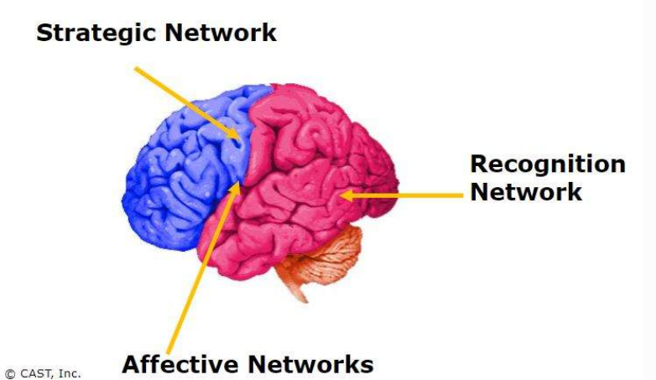
UDL and the Learning Brain
To learn, we must
Recognize information and concepts
Apply strategies to process
Be engaged
Three brain networks
Affective
Recognition
Strategic
Notes:
Research on the human brain tells us that, to learn, we must recognize information, ideas, and concepts, and be able to apply strategies to process information. We must be engaged in and paying attention to the learning.
Neuroscience has identified three primary brain networks and the roles they play in learning. This recent research shows that, while the three networks work together, each one processes information differently. The way we learn is as individual as our DNA or fingerprints.

Slide 7
Affective Networks
Support the “why” of learning
What motivates students to engage
Example: start a lesson by generating interest in a reading topic based on student interest
Teacher trainers can consider these networks for PD
Example: choose timely topics, help teachers understand the relevance
Notes:
The first brain networks are the affective brain networks. Affective brain networks support the "why" of learning. They help us understand what motivates students to engage and pay attention to their learning. These networks help teachers know what challenges, excites, or interests their students. Teachers use that knowledge to design instruction. For example, they might start a lesson by generating interest in a reading topic or a mathematics concept based on something in the student's environment. Teacher trainers can consider affective networks when they design teacher professional development by choosing timely topics and helping teachers see the relevance of the PD.

Slide 8
Recognition Networks
Support the “what” of learning
Collect and categorize information in meaningful ways
Example: instruction that includes identifying an author’s writing style
Teacher trainers can consider these networks for PD
Example: analyze videos of lessons to identify examples of instructional strategies
Notes:
The second of the brain networks, the recognition networks, focus on collecting and categorizing information in a meaningful way, including how we identify and categorize what we see, hear, and read. For example, instruction for students that includes identifying letters, words, or an author's writing style are recognition tasks—the "what" of learning. In professional development, trainers might target the recognition network by having teachers analyze videos of lessons to identify examples of instructional strategies.

Slide 9
Strategic Networks
Support the “how” of learning
Plan and carry out tasks, organize and express ideas
Example: writing an essay or solving a math problem
Teacher trainers can consider these networks for PD
Teachers design an assessment with multiple options to demonstrate learning
Notes:
Last, strategic learning networks include ways that learners demonstrate what they have learned. These include how students plan and carry out tasks, as well as how they organize and express ideas. For example, writing an essay or solving a mathematics problem are strategic tasks for students—the "how" of learning. In professional development, trainers may target these strategic networks by having teachers design an assessment with multiple options for students to show what they have learned.

Slide 10
UDL Principles Designed Around Brain Networks
Multiple means of engagement (affective networks)
Regulate learning, sustain effort and motivation, stay engaged and interested
Multiple means of representation (recognition networks)
Reach higher levels of comprehension and understanding, understand symbols and expressions, perceive what needs to be learned
Multiple means of action and expression (strategic networks)
Act strategically, express fluently, respond physically
Notes:
The UDL principles are designed around these three "learning brain networks." These principles include multiple means of engagement, which is related to affective networks and provides options for learners to regulate their own learning, sustain effort and motivation, and stay engaged and interested. Multiple means of representation is related to the recognition networks and provides options for learners to reach higher levels of comprehension and understanding, understand symbols and expressions, and perceive what needs to be learned. Multiple means of action and expression is related to the strategic networks and provides options for learners to act strategically, express themselves fluently, and respond physically.

Slide 11
UDL Principles Designed Around Brain Networks (2)
Learning is contextual
Fosters students’ abilities to
Participate
Collaborate
Ask questions
Share ideas
Self-evaluate
Set goals
Notes:
All learning is contextual. The learning networks together coordinate all knowledge and skill output. Quality instruction means knowing how learners take in information and determining what they know through their responses. The learning brain networks support many of the underlying cognitive objectives we have for learners as they learn to use information and ideas in a variety of ways. We want to foster their ability to participate in learning, collaborate with others, ask questions, share ideas, self-evaluate their learning, and set goals.

Slide 12
Activity
Describe UDL in your own words to a co-worker who is unfamiliar with this framework. What would you make sure to include?
Notes:
Let's have a quick small-group discussion! Describe UDL in your own words to a co-worker who is unfamiliar with this framework. What would you make sure to include? (ask groups to share out-loud.)
Possible responses include: framework to improve teaching and learning, three brain networks, UDL principles, multiple means of engagement, representation, action, and expression, based on research on how people learn

Slide 13
Engagement
Notes:
Let's dive deeper into the first UDL principle, multiple means of engagement.

Slide 14
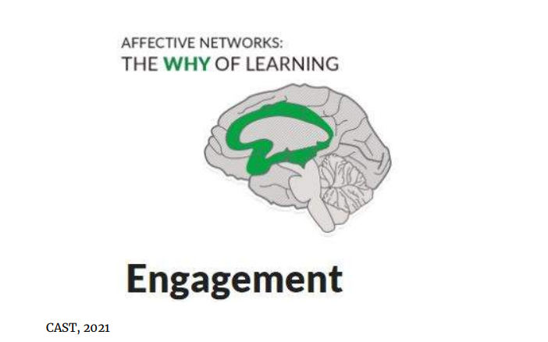
Affective Networks: The “Why of Learning”
Aligned to multiple means of engagement
Provides options for
Creating interest
Sustaining effort and persistence
Self-regulation
Notes:
The affective networks address the "why" of learning. This is aligned to the UDL principle of multiple means of engagement. These networks evaluate and set priorities, allowing learners to engage in learning. Engagement is essential for learning. Individual differences mean learners are interested in and will engage with different things. The affective networks are fundamental to learning.
Multiple means of engagement supports learning by providing options for creating interest in the subject, supporting learners in sustaining effort and persisting through tasks, as well as self-regulation, the ability to modulate one's emotional reactions.

Slide 15
Examples of Multiple Means of Engagement
Provide choices and autonomy
Include familiar, relevant contexts in learning opportunities
Encourage learners to reflect on their learning
Vary the demands of the tasks for students
Notes:
Examples of multiple means of engagement include: providing learners choices and autonomy as much as possible; including familiar, relevant contexts in learning opportunities; supporting activities that encourage learners to reflect on their learning; and varying the demands of the tasks for students.

Slide 16
Multiple Means of Engagement: A Teacher's Ideas
“Sophia loves science.”
“I wonder how to engage her in math lesson.”
“She likes butterflies, bees, and ladybugs.”
“I’ll use images of insects and let her choose two to identify repeating patterns.”
“I’ll make her a chart so she can keep track of how many patterns.”
Notes:
Let's explore an example student, Sophia, and her teacher. Her teacher tells us, "Sophia is a fifth-grade student in my class who loves science. She uses an AAC device to communicate. I’m wondering how to engage her in our math lesson on identifying and extending numerical patterns. I noticed that she shows interest in butterflies, ladybugs, and bees in our science lesson on life cycles.”
"Perhaps I could use images of those insects and let her choose two to use to identify short repeating patterns? Then she could pick two to extend other patterns. Eventually, she can use numbers to make patterns. I'll make her a chart so she can keep track of how many patterns she makes and what kinds, so she can self-assess.”

Slide 17
Think About: Multiple Means of Engagement
Connect content to Sophia’s interests, incorporating bees and butterflies in the lesson
Sophia has a choice of using butterflies or bees to make and identify repeating patterns
Sophia uses a chart to track progress
Notes:
Think about: How Sophia's teacher is providing multiple means of engagement. He is connecting content to Sophia's interests, incorporating butterflies and bees. Sophia is given a choice of using butterflies or bees to make and identify repeating patterns. Sophia will use a chart to track her progress on making and extending patterns.

Slide 18
Multiple Means of Engagement in PD Design
Choose meaningful, timely topics
Connect the PD to larger goals
Provide a "takeaway" that teachers can apply right away, illustrating the relevance of the PD
Notes:
The affective brain networks are aligned to the UDL principle of multiple means of engagement. Here are examples for how the affective networks are relevant in PD design.
First, choose meaningful, timely topics for PD; connect the PD to larger goals within a school or district; and then provide a "takeaway" that teachers can apply right away, illustrating the relevance of the PD.

Slide 19
Activity (1)
Think about the greatest challenges you or teachers you know have with engaging learners.
Identify one example of how teachers can provide multiple means of engagement when planning lessons or activities, or
Choose an example of how you can use multiple means of engagement in planning your PD.
Notes:
Time for another small-group discussion! Think about the greatest challenges you or teachers you know have with engaging learners. Identify one example of how teachers can provide multiple means of engagement when planning lessons or activities, or choose an example of how you can use multiple means of engagement in planning your PD. (Ask groups to share out-loud.)
Potential responses include (for one example of how teachers can provide multiple means of engagement): connect lesson to student interests, give students choices, provide a way for students to track progress.
Potential responses include (for choosing an example of how you can use multiple means of engagement in planning PD): meaningful, relevant PD topics, connect PD to larger district goals, make sure teachers have a takeaway, include opportunities to engage and connect with others.

Slide 20
Representation
Notes:
Let's move to the next UDL principle, multiple means of representation.

Slide 21
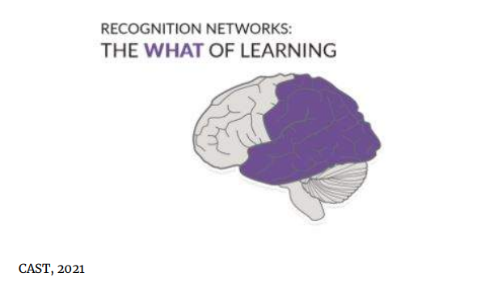
Recognition Networks: The “What of Learning”
Aligned to multiple means of representation
Provide options for
Perception (sensory information)
Understanding language
Understanding concepts
Notes:
The recognition networks, located in the back of the brain, help us identify and interpret sound, light, taste, smell, and touch, which are essential to learning. This network is aligned to the UDL principle of multiple means of representation. By providing different ways for learners to participate—“hear it, see it, feel it”—through sensory and real-world experiences, the “what” of learning is supported.
Representation supports learning by providing options for perception (interpreting sensory information), understanding language, and understanding concepts.

Slide 22
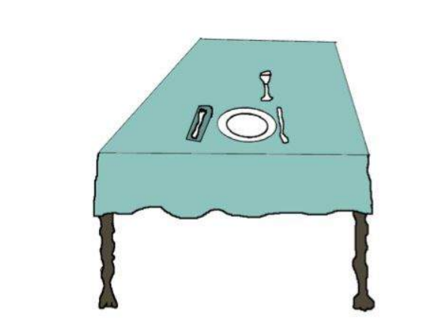
Try This Exercise
Can you identify this object?
How about now?
Recognition networks rely on context.
Notes:
Try this exercise. When you see this shape within a context, you are easily able to identify it. Recognition networks rely on context. Learners differ in the ways they perceive and comprehend information that is presented to them. The UDL principle of multiple means of representation is demonstrated during instruction when we give learners various ways of acquiring information and knowledge, such as options for displaying content.

Slide 23
Examples of Multiple Means of Representation
Use assistive technology, modify a display
Provide video or audio supplements
Embed support for vocabulary within a text
Notes:
Examples of multiple means of representation include allowing learners to change the display (using their own computer settings) and engage with content using assistive technology, if needed; providing video or audio supplements, when available, in addition to printed, text-based sources, for learners who benefit most from visual and auditory presentation of concepts; and embedding support for unfamiliar references or vocabulary within a text or resource.

Slide 24
Multiple Means of Representation: A Teacher's Ideas
“Sophia is observing life cycle of butterflies.”
“I wonder how to represent life cycle.”
“We can watch a video time-lapse.”
“She can use a calendar to identify each stage.”
“She will have access to core and fringe vocabulary.”
Notes:
Let's revisit Sophia and her teacher! Sophia’s teacher says, “In science, we are observing the life cycle of a butterfly. I am wondering about the best way to help Sophia comprehend the sequence of stages of growth and development. We are watching an actual butterfly go through the four stages of egg, larva, pupa, and adult. But I wonder if the real-life timeframe of over a month will be too abstract for her.” “Perhaps we can watch a video time-lapse of the cycle first, then develop a butterfly calendar to record with pictures when each stage occurs. When the butterfly emerges, we can watch the video again and use the calendar to identify each stage we recorded. I will make sure Sophia has access to the core and fringe vocabulary she needs to do this work.

Slide 25
Think About: Multiple Means of Representation
Sophia watches a time-lapse video.
Sophia uses a calendar to identify cycle phases.
Sophia has access to vocabulary.
Notes:
Think about: How Sophia's teacher is providing multiple means of representation. He makes a time-lapse video of the butterfly development cycle for Sophia's reference. Sophia uses a calendar to identify phases of a butterfly's life cycle. Sophia has access to core and fringe vocabulary to be a part of the science lesson.

Slide 26
Multiple Means of Representation in PD Design
Teachers can analyze videos of students to identify instructional strategies used
Model or role-play new strategy
Notes:
The recognition brain networks are aligned to the UDL principle of multiple means of representation. Examples of how the recognition network can be used in PD design include having teachers analyze videos of students learning to identify instructional strategies used, and modeling or role-playing how to implement an instructional strategy.

Slide 27
Activity (2)
What kinds of challenges might teachers face when trying to represent abstract concepts in their teaching?
Identify one example of how teachers can provide multiple means of representation when planning lessons or activities, or
Identify one way of how you can use multiple means of representation to plan PD.
Notes:
Let's get back into small groups to discuss multiple means of representation! What kinds of challenges might teachers face when trying to represent abstract concepts in their teaching? Identify one example of how teachers can provide multiple means of representation when planning lessons or activities, or identify one way of how you can use multiple means of representation to plan PD. (Ask group to share out-loud.)
Potential responses include (for one example of how teachers can provide multiple means of representation): use videos or audio, use an organizer (like a calendar in Sophia’s case), provide access to necessary vocabulary.
Potential responses include (for choosing an example of how you can use multiple means of engagement in planning PD): have teachers analyze videos of a new instructional strategy, model or role-play a new strategy, provide options for asynchronous learning.

Slide 28
Action and Expression
Notes:
Let's now discuss the last UDL principle, multiple means of action and expression.

Slide 29
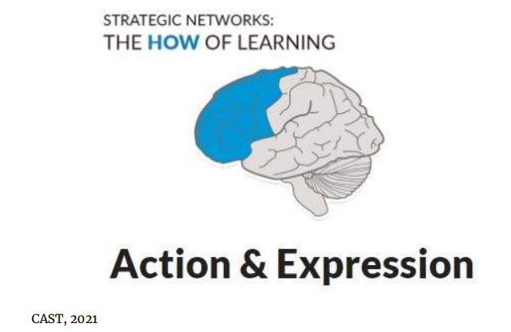
Strategic Networks: The “How of Learning”
Aligned to multiple means of action and expression
Provides options for
Expression and communication
Physical actions
Executive function
Requires organization and strategy
Notes:
The strategic networks are located in the front part of the brain and enable us to plan, execute, and monitor actions and skills. These networks are aligned to the UDL principle of multiple means of action and expression. In learning situations, the strategic networks are critical. They work in tandem with recognition networks to help learners read, compute, write, solve problems, and plan and execute projects.
Learners differ in the ways that they show what they have learned. There is no single means of action and expression, so it is important that there are options for learners. In addition, action and expression requires organization and strategy. Providing options and scaffolding for executive functions, including goal-setting and monitoring goal progress, is another component of this UDL principle.

Slide 30
Examples of Multiple Means of Action and Expression
Flexible ways for students to demonstrate their learning, including
telling
writing
touching
drawing
eye gaze
pointing
using sign language
using an AAC device
accessing tools and assistive technologies
Notes:
Multiple means of action and expression include flexible ways for students to demonstrate what they know, including: telling, writing, touching, drawing, eye gaze to the correct answer, pointing to the correct answer, using sign language, using an AAC device, and accessing tools and assistive technologies.

Slide 31
Multiple Means of Action and Expression: A Teacher's Ideas
“Sophia doesn’t yet use letters in writing.”
“We are working on writing about events including 3+ sequences.”
“She can put pictures of herself and family on vacation in order and write a caption.”
“She will have a goal of sharing her story with classmates.”
Notes:
Let's go back to Sophia and her teacher one last time! “Involving Sophia in lessons on writing is difficult, since she doesn’t yet use letters in a way others can understand. The class is working on writing about events or personal experiences including three or more events in sequence.
“Perhaps she can use pictures of herself that her parents shared of their family vacation. Sophia could select three pictures from the set and indicate what happened first, next, and last. With support, she could identify the event in the picture and use a pencil to write a caption for each picture, with marks or scribbles that are meaningful to her. She can have a goal to share her story with her classmates by showing them the sequence of the pictures, and I could help her interpret her captions.”

Slide 32
Think About: Multiple Means of Action and Expression
Using vacation pictures to demonstrate a sequence of events
Sophia writes a caption for her photos
Sophia sets a goal
Notes:
Think about: How Sophia's teacher is providing multiple means of action and expression. He is using pictures of Sophia’s vacation to demonstrate the sequence of events and communicate her ideas, having Sophia write a caption for her photos, and helping Sophia set and reach a goal.

Slide 33
Multiple Means of Action and Expression in PD Design
Teachers design an assessment that includes multiple options for students to respond.
Teachers draft a goal to implement an instructional strategy and create a plan to monitor goal progress.
Notes:
The strategic brain network is aligned to the UDL principle of multiple means of action and expression. Examples for how the strategic network can be used in PD design include asking teachers to design an assessment that includes multiple options for students to respond, and having teachers draft a goal to implement an instructional strategy and asking them to create a plan to monitor their progress to that goal.

Slide 34
Activity (3)
What kinds of challenges might teachers face when they are considering how a student will demonstrate what they have learned?
Identify one example of how teachers can provide multiple means of action and expression when planning lessons, or
Identify a way you can incorporate multiple means of action and expression in your PD.
Notes:
Time for our last small-group discussion! What kinds of challenges might teachers face when they are considering how a student will demonstrate what they have learned? Identify one example of how teachers can provide multiple means of action and expression when planning lessons, or identify a way you can incorporate multiple means of action and expression in your PD. (Ask groups to share out.)
Potential responses include (for one example of how teachers can provide multiple means of action and expression): provide photos or visual supports for students to show what they have learned or communicate ideas, allow other ways to communicate ideas such as telling or drawing, help students set a goal and work towards it.
Potential responses include (for choosing an example of how you can use multiple means of action and expression in planning PD): have teachers design assessment that includes multiple ways for students to demonstrate their learning, have teachers draft a goal to implement a new strategy, have teachers draft a plan for monitoring that goal.

Slide 35
Summary
UDL draws from neuroscience, the learning sciences, and cognitive psychology.
UDL builds on three different networks for knowledge development in our brains—recognition, strategic, affective.
The UDL framework describes how the learning brain intersects with effective instruction.
Notes:
In summary, UDL draws from neuroscience, the learning sciences, and cognitive psychology. UDL builds on three different networks for knowledge development in our brains—recognition, strategic, and affective. The UDL framework describes how the learning brain intersects with effective instruction. UDL-related choices that teachers and instructors make impact learning by reducing barriers.

Slide 36
Thank You!
Notes:
Thank you so much for your attention! (can give evaluation survey if you choose)

